Slide 1

CISC 250 – Business Telecomm Networks
Lab 1
- Introduction to Wireshark

Slide 2
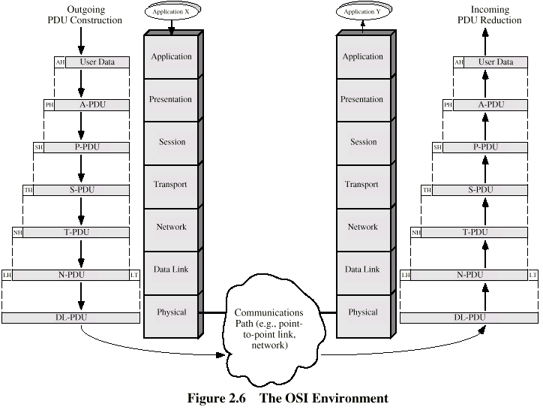
Recap - Encapsulation

Slide 3
Message Communication in Hybrid TCP/IP-OSI
Application
Layer
HTTP Msg
Application
Layer
Transport
Layer
TCP Seg
Transport
Layer
Internet
Layer
IP Packet
Internet
Layer
Internet
Layer
Data Link
Layer
Ethernet
Frame
Data Link
Layer
Data Link
Layer
Data Link
Layer
Physical
Layer
Physical
Layer
Physical
Layer
Physical
Layer
Ethernet Switch
Router
Client PC
Server

Slide 4
Recap - HTTP request message
two types of HTTP messages: request, response
HTTP request message:
ASCII (human-readable format)
request line
(GET, POST,
HEAD commands)
GET /somedir/page.html HTTP/1.1
Host: www.someschool.edu
User-agent: Mozilla/4.0
Connection: close
Accept-language:fr
(extra carriage return, line feed)
header
lines
Carriage return,
line feed
indicates end
of message

Slide 5
Recap - HTTP response message
status line
(protocol
status code
status phrase)
HTTP/1.1 200 OK
Connection close
Date: Thu, 06 Aug 1998 12:00:15 GMT
Server: Apache/1.3.0 (Unix)
Last-Modified: Mon, 22 Jun 1998 …...
Content-Length: 6821
Content-Type: text/html
data data data data data ...
header
lines
data, e.g.,
requested
HTML file

Slide 6
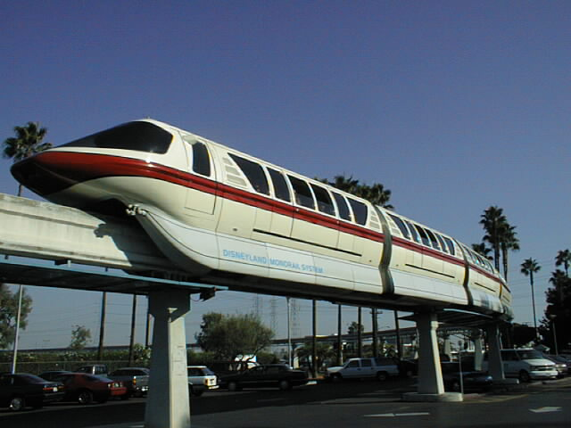
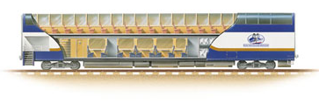
Packet Sniffing
Currently Data just travels around your network like a train. With a packet sniffer, get the ability to capture the data and look inside the packets to see what is actually moving long the tracks.

Slide 7
Packet Sniffing
Sometimes referred to as Network Monitoring Tools
Can be used legitimately by network and system administrators to verify network traffic and diagnose problems
Can be used to determine what systems and protocols are unprotected/unencrypted in a network and take action (good/bad)
Can be used to obtain critical information (passwords, cc numbers; anything unencrypted that is transmitted over the network) by malicious hackers

Slide 8
Packet Sniffing : Tools
Wireshark (http://www.wireshark.org/)
King of the Packet Analyzers!
Available for Linux, Unix, Windows
Requires WinPcap for Captures
tcpdump
The original packet sniffer
Ships by default with many versions of linux
Many more . . .

Slide 9
Wireshark Application

Slide 10
Display Filter
Note the box at the top of Wireshark for display filters
Select only some of the packets captured for display
The comparison operators can be expressed either through C-like symbols, or through English-like abbreviations:
eq, == Equal
ne, != Not equal
gt, > Greater than
lt, < Less Than
ge, >= Greater than or Equal to
le, <= Less than or Equal to

Slide 11
Advanced Filtering
Filter for just that stream
(ip.addr eq 207.46.133.140 and ip.addr eq 172.17.22.56) and
(tcp.port eq 21 and tcp.port eq 3511)
Filter for traffic between two hosts
ip.addr == 207.46.133.140 and ip.addr == 172.17.22.56
Filter for IP Traffic and removal of other traffic
ip and !(nbns) and !(msnms) and !(browser) and !(rip)

Slide 12
Capture Filters
The capture filter syntax follows the rules of the pcap library
This syntax is different from the display filter syntax.
Sample filters
src ip 192.168.1.1
ether src 00:50:BA:48:B5:EF

Slide 13
More On Capture Filters
A capture filter for HTTP that captures traffic to and from a particular host
tcp port 80 and host 10.10.10.5
A capture filter for HTTP that captures traffic not from a particular host
tcp port 80 and not host 10.10.10.5
A capture filter to and from an ethernet address
ether 00:00:01:01:02:22

Slide 14
Lab 1
Test Run: http://gaia.cs.umass.edu/wireshark-labs/INTRO-wireshark-file1.html
Basic HTTP request/response http://gaia.cs.umass.edu/wireshark-labs/HTTP-wireshark-file1.html
HTML with Embedded Objects http://gaia.cs.umass.edu/wireshark-labs/HTTP-wireshark-file4.html
HTTP to TCP http://gaia.cs.umass.edu/wireshark-labs/HTTP-wireshark-file3.html
HTTP CONDITIONAL GET/response http://gaia.cs.umass.edu/wireshark-labs/HTTP-wireshark-file2.html

Slide 15
Downloading a Complex Webpage with Two Graphics Files
HTML Document
HTML Document
Browser
Webserver
Application
Client PC
2
Graphics
Files
Webserver
Download Requires 3
HTTP Request-Response Cycles;
Downloads HTML Page First
It has Tags to Identify Other Files
As
Displayed

Slide 16
Downloading a Complex Webpage with Two Graphics Files
Browser
Webserver
Application
Client PC
2
Graphics
Files
Webserver
Based on Tags in HTML Document,
Browser Requests Downloads of
Remaining Graphics or Other Files
Browser Renders Combined Webpage on Screen
As
Displayed

Slide 17


